Slide 1

S+4 hospital building of Kalyani das and bichitra nanda
Banika, Odisha

Slide 2



Slide 3
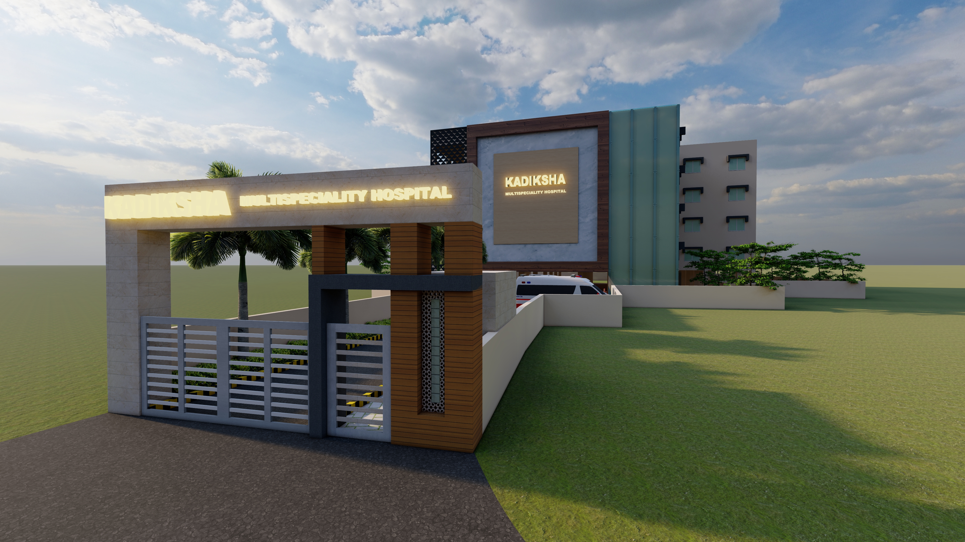

Slide 5
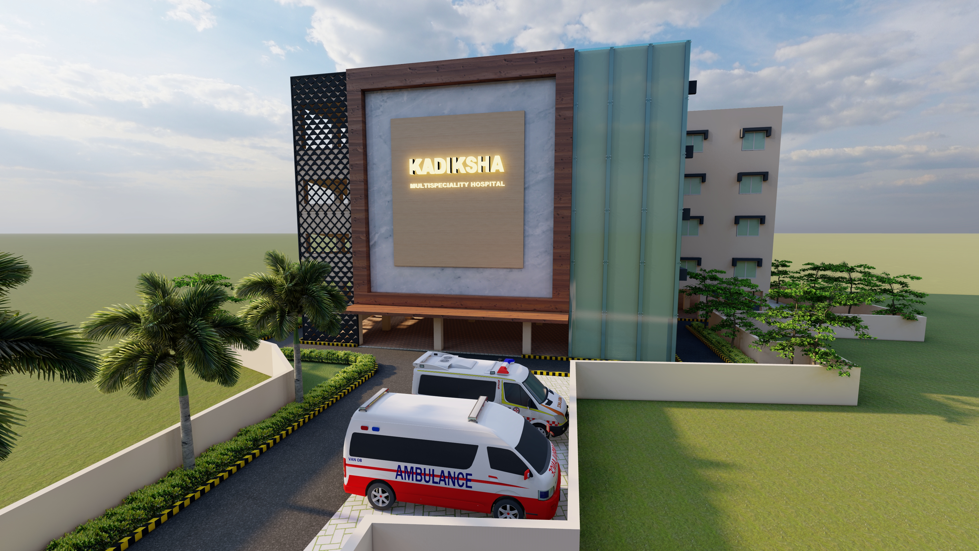

Slide 6
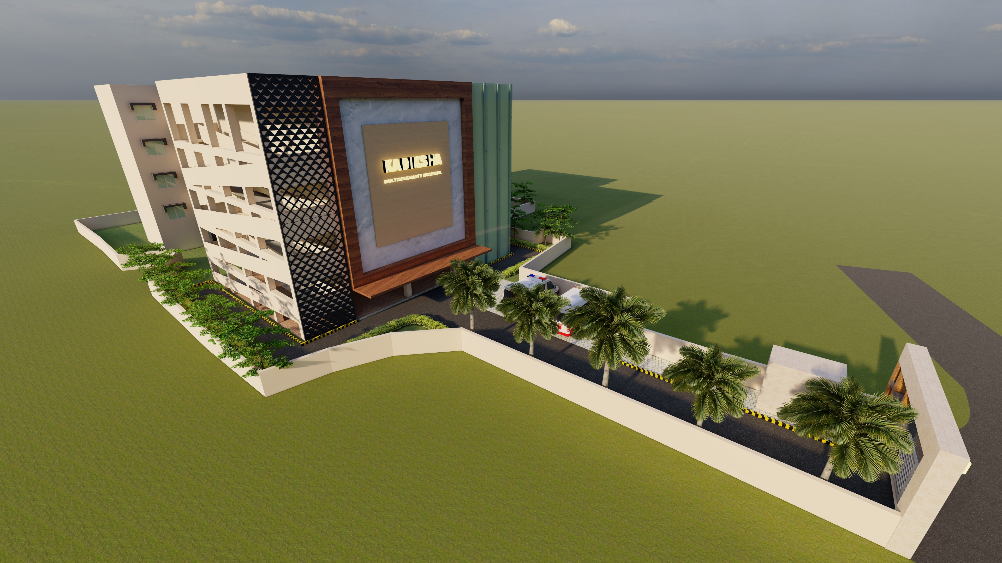

Slide 7
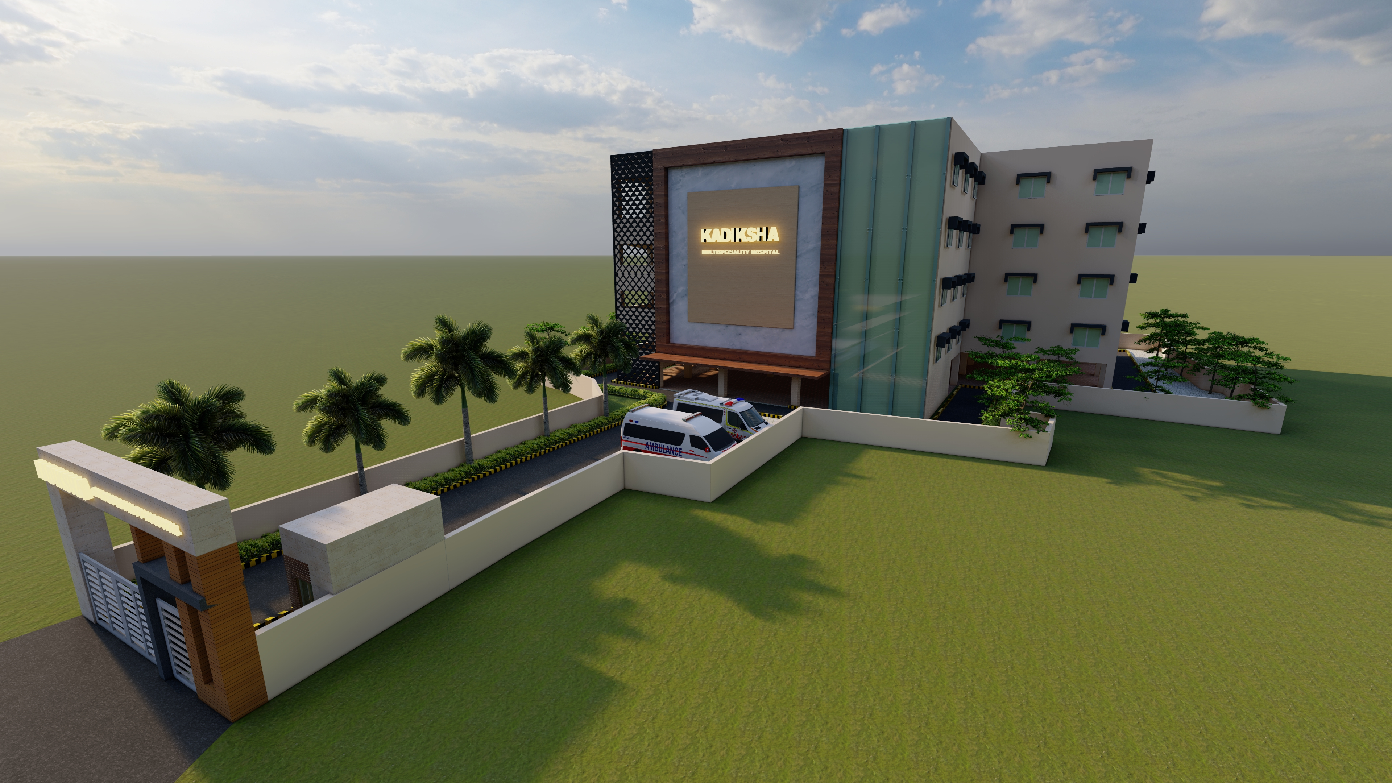

Slide 8
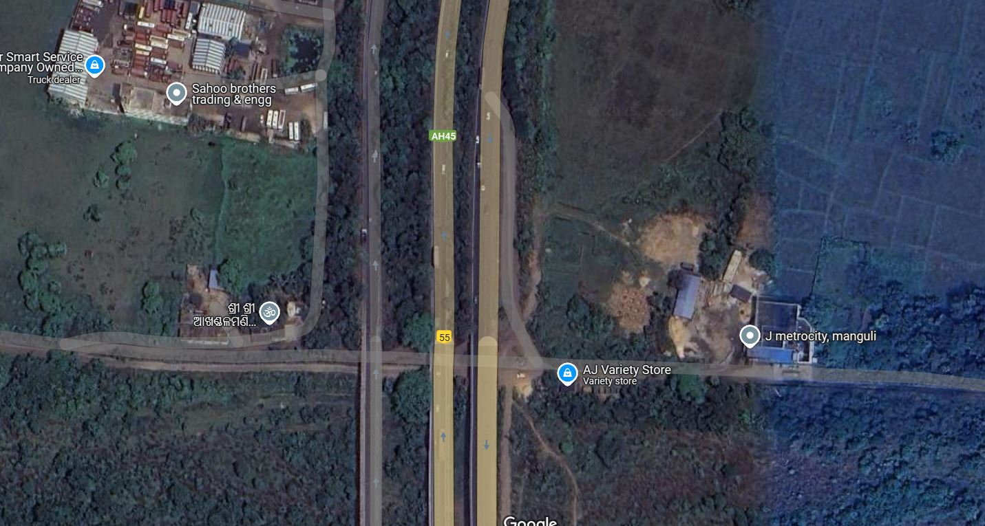
site
Approach road – SERVICE ROAD TO NH -16
Mouza – Banika
District - Cuttack

Slide 9
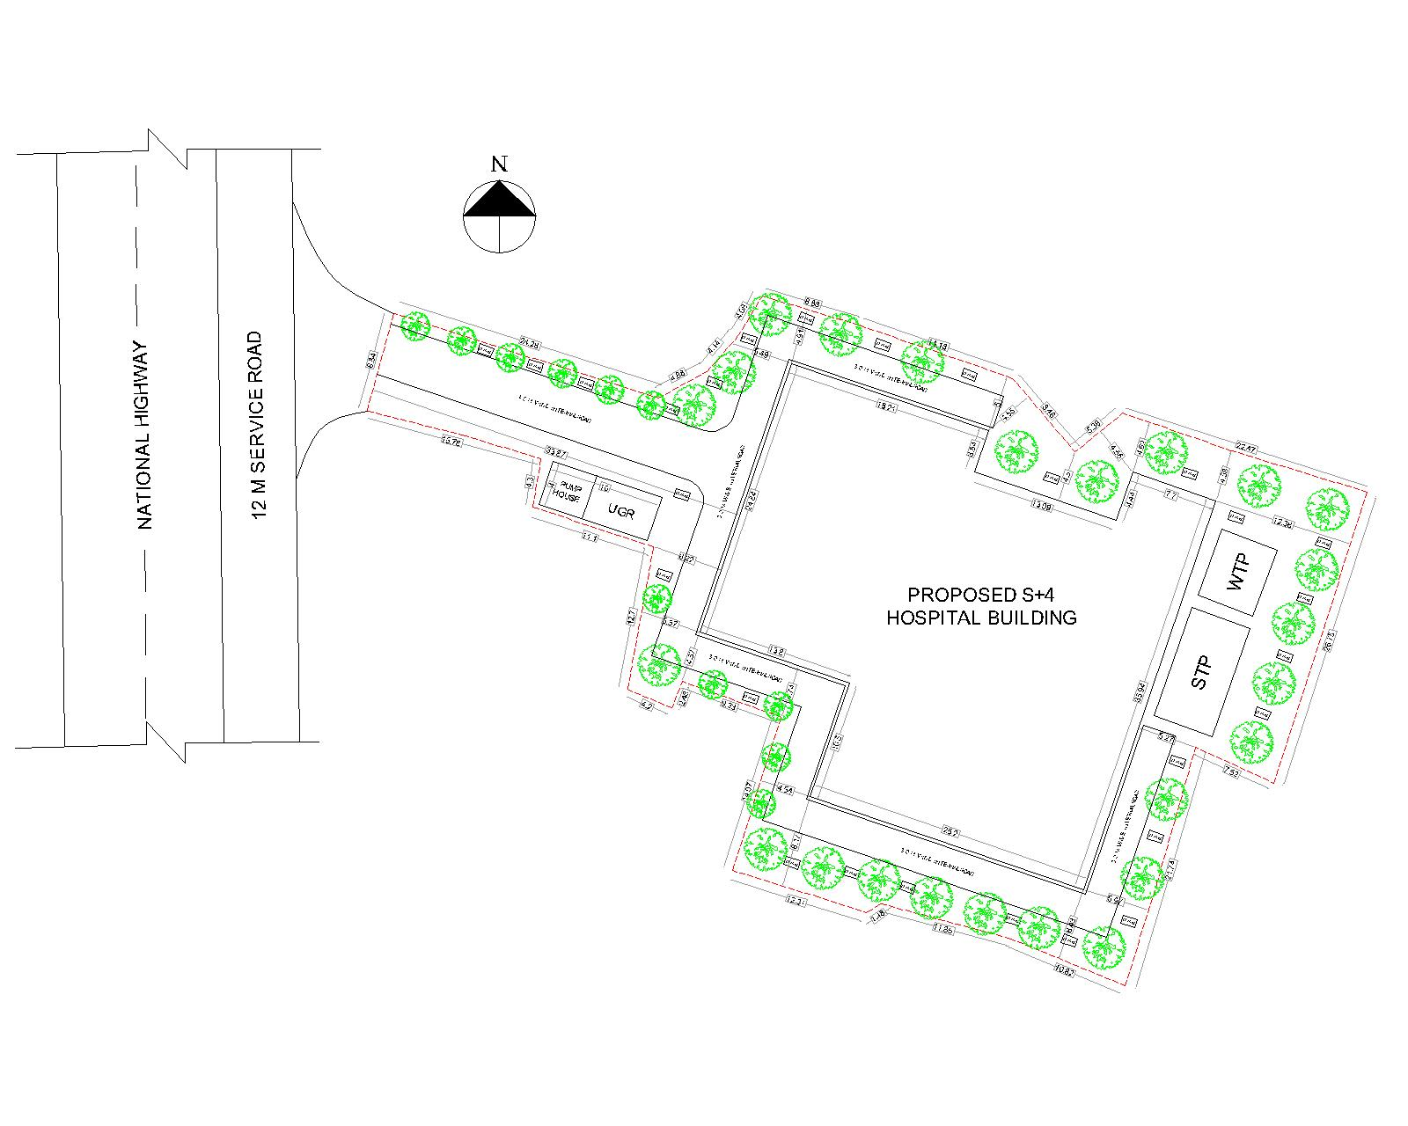
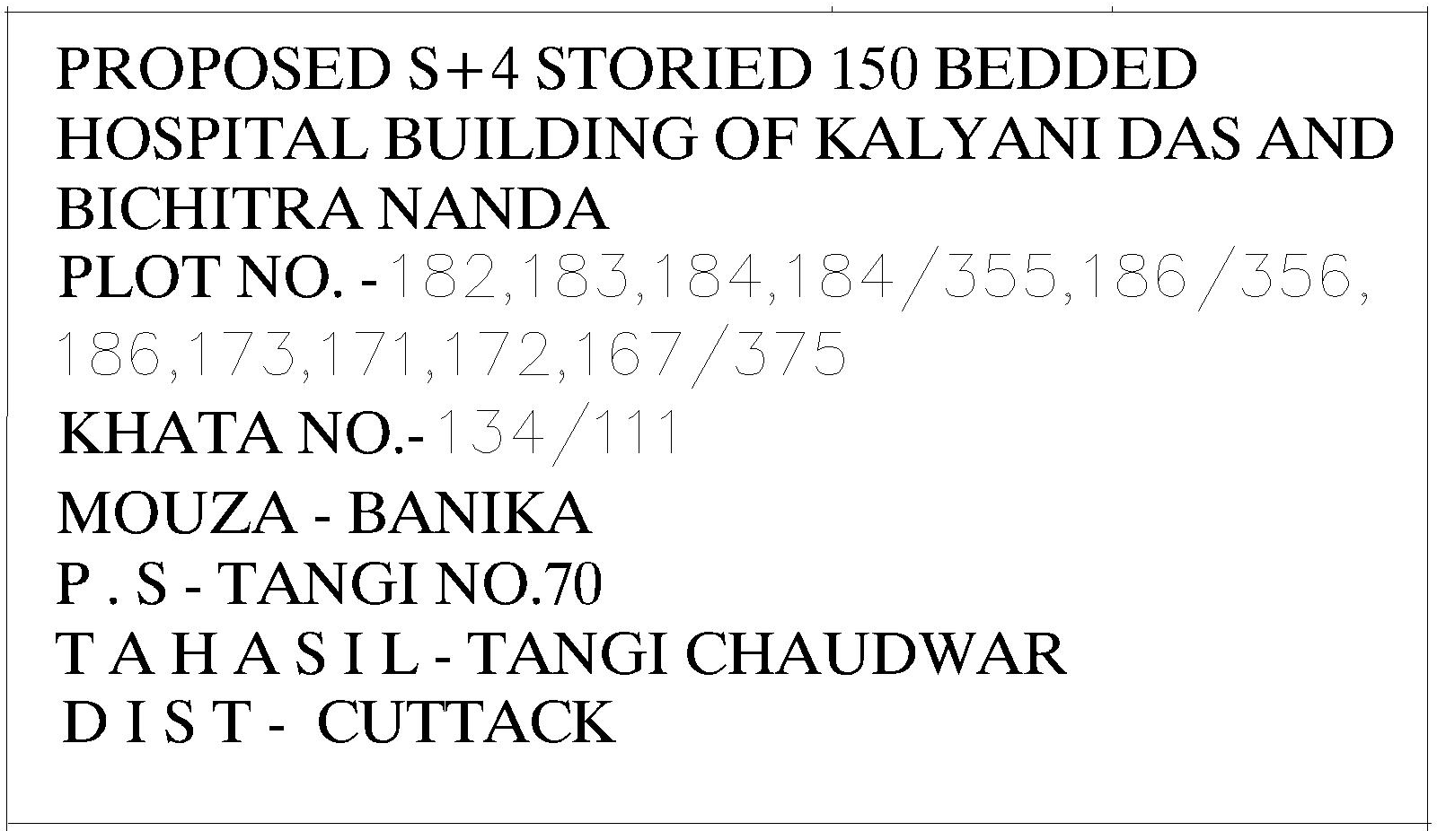
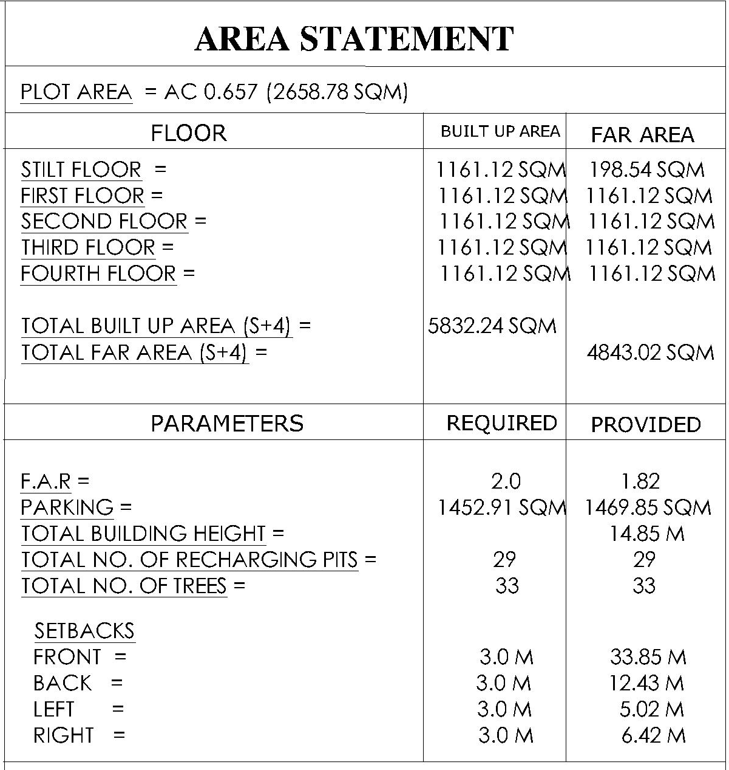
Site plan

Slide 10
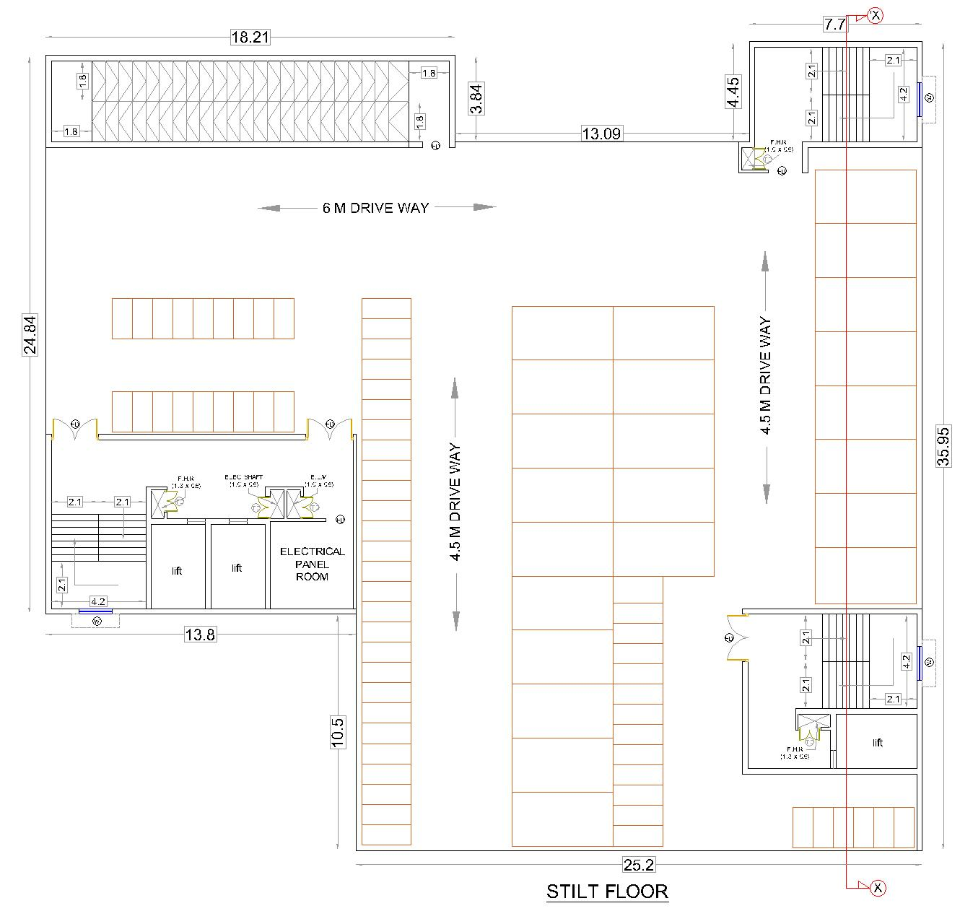
STILT floor
PARKING
LIFT AND STAIRCASE LOBBY
RAMP
ELECTRICAL PANEL ROOM

Slide 11
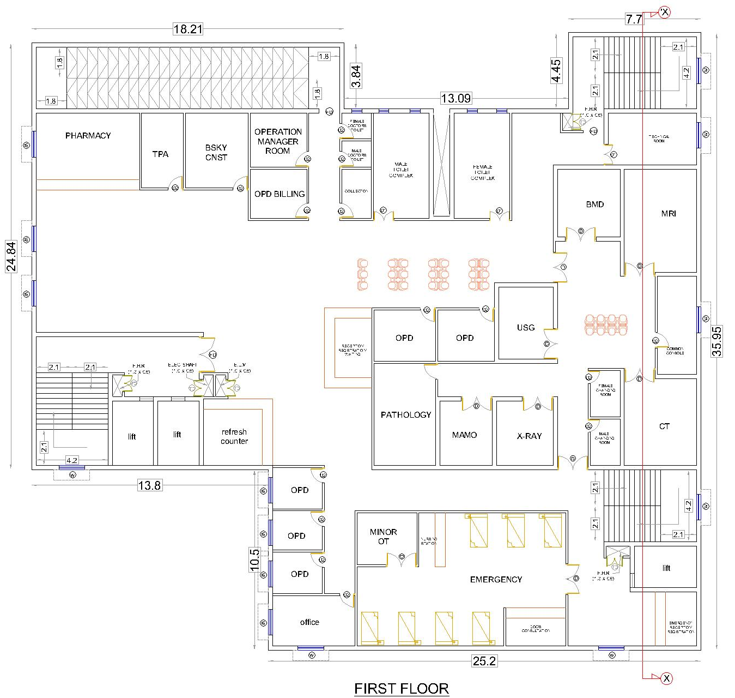
First floor
RECEPTION AND WAITING AREA
EMERGENCY
OPD SECTION
DEPARTMENT OF RADIOLOGY
PHARMACY
TOILET COMPLEX

Slide 12
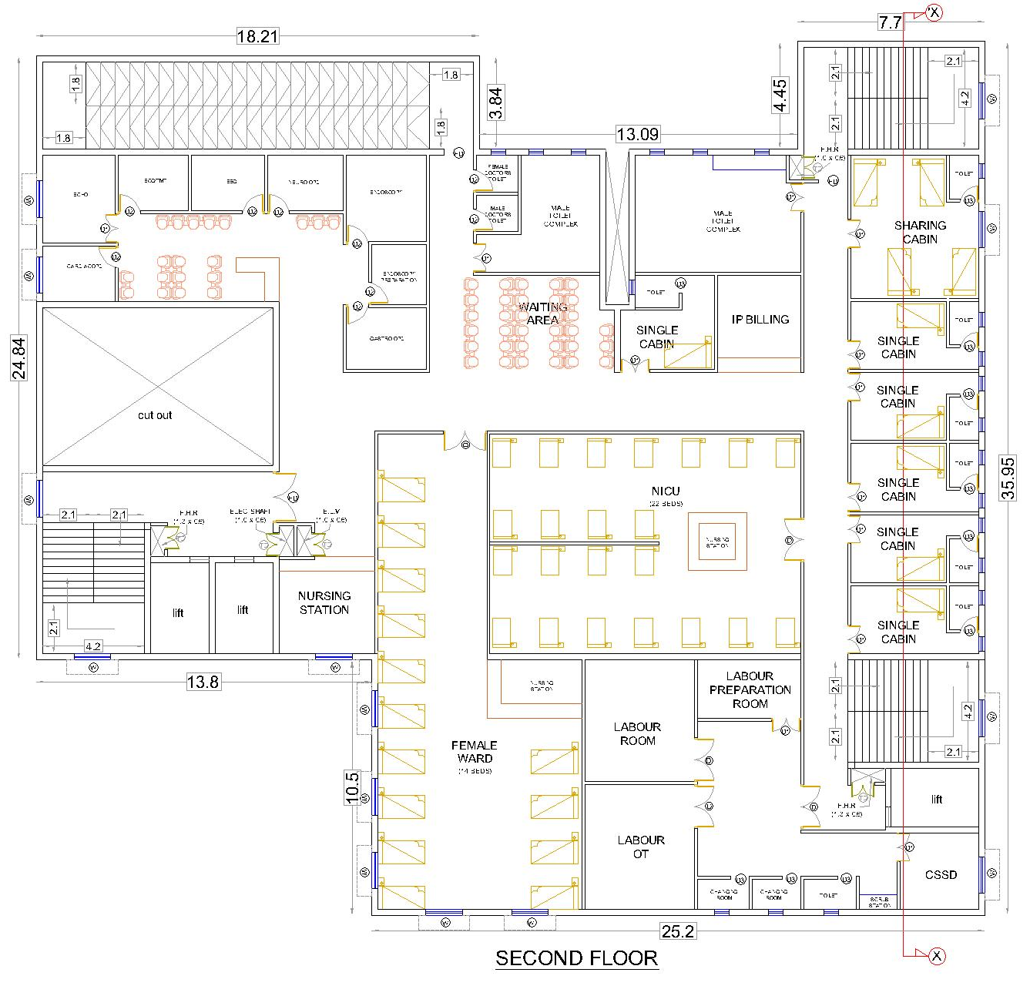
SECOND floor
SUPER SPECIALITY OPD
LABOUR DEPARTMENT
NICU
FEMALE WARD
SINGLE CABIN
SHARING CABIN
TOILET COMPLEX

Slide 13
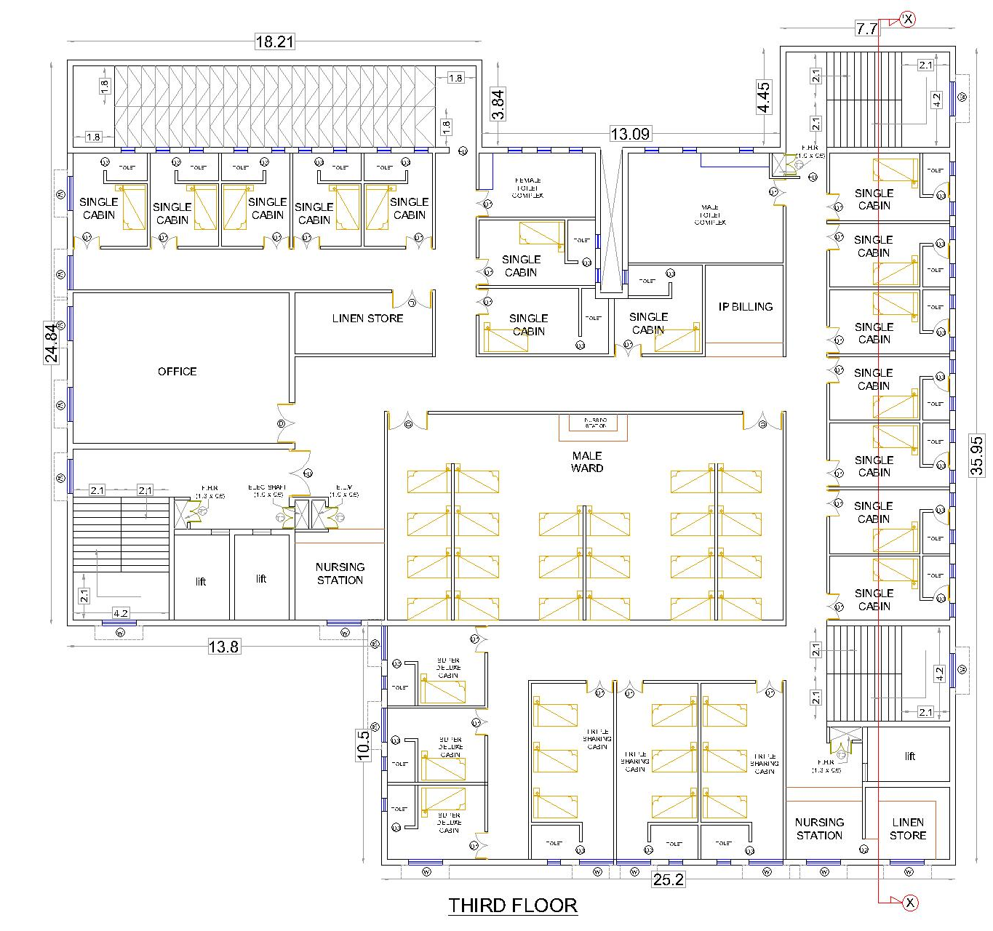
THIRD floor
OFFICE
MALE WARD
SINGLE CABIN
SHARING CABIN
TOILET COMPLEX

Slide 14
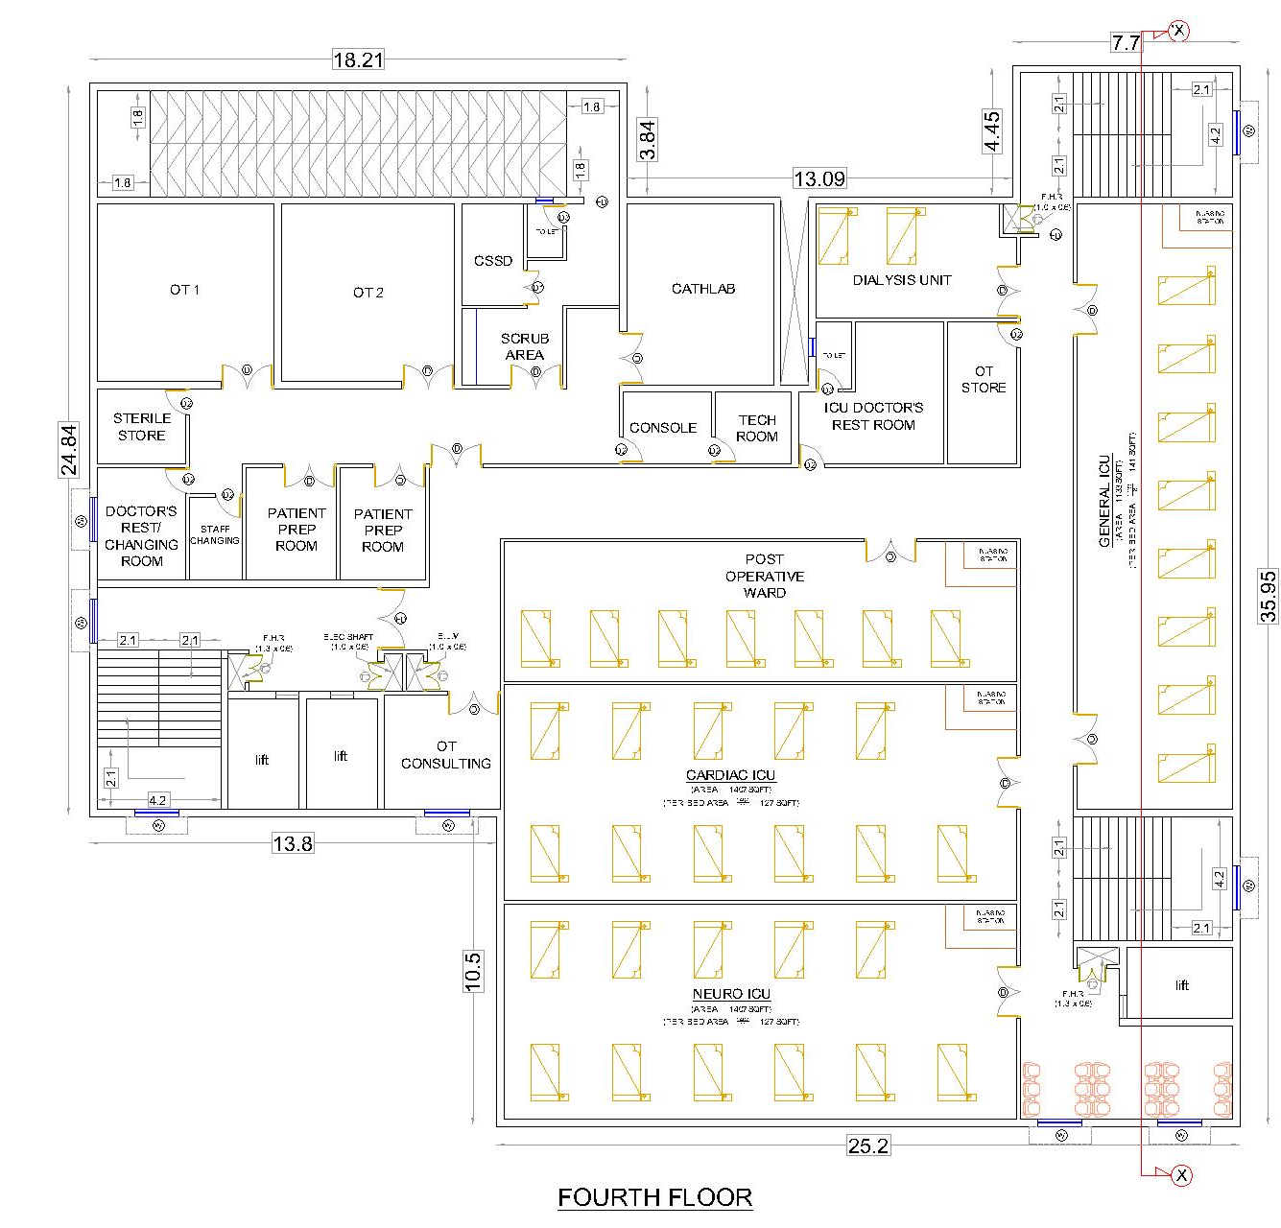
FOURTH floor
OT SECTION
OT COUNSELLING
CATH LAB
POST OPERATIVE WARD
CARDIAC ICU
NEURO ICU
GENERAL ICU
DIALYSIS UNIT

Slide 15
Thank you.
MANOEURVE
GAJAPATI NAGAR, BBSR

